Slide 1
CREDIT CARD FRAUD DETECTION
JAYARETHANAM PILLAI , QI RUI

Slide 2
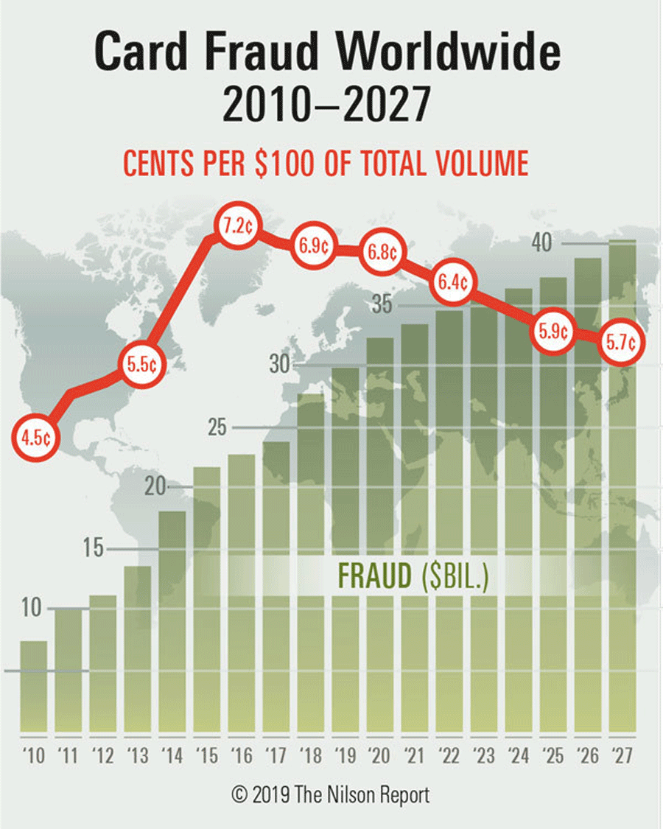
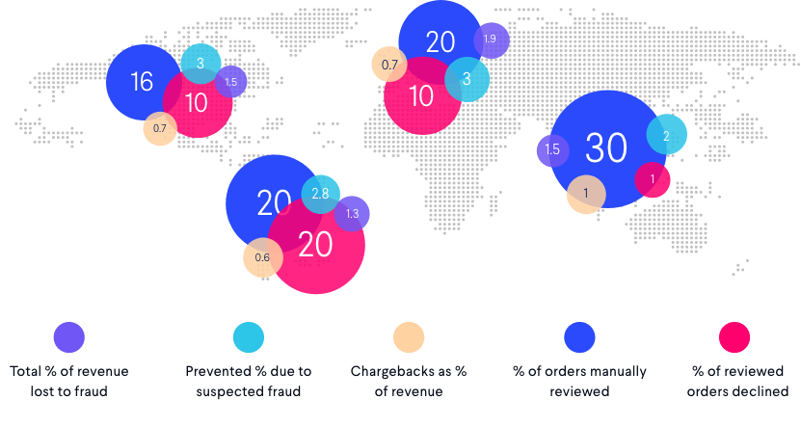
BUSINESS & D.A. OBJECTIVES
DETECT FRAUD
TIME SENSITIVE DATA
ANOMALY DETECTION
BUSINESS
RECOMMENDATIONS
Notes:
Credit card fraud is the most common type of identity theft, according to a 2020 Federal Trade Commission report.
The U.S. is #1 in Cases of Credit Card Fraud - Nilson Report, the United States eclipses every country on the planet as the most credit fraud-prone, with 38.6% of all reported card fraud losses in 2018. And how much was lost in the illegal transactions? A cool $9.47 billion.
The whole world loves online shopping. The global ecommerce market is predicted to grow to 4.9 trillion US dollars by 2021. In 2018, one in every ten dollars spent globally was spent online, and by 2022 online sales will make up 17% of all global consumer sales.
Between 1988 and 1998, Visa and Mastercard lost $750 million to credit card fraud
Detect a transaction if it is a fraud or not ?
Using time sensitive information to detect fraudulent transaction
Dealing with imbalanced dataset?
Basic data analytics assessment to get feel for the overall mode of play

Slide 3
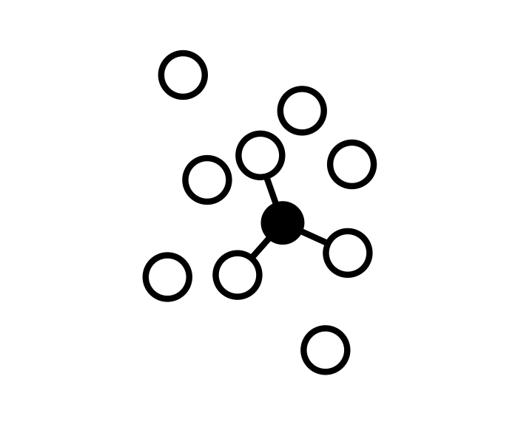




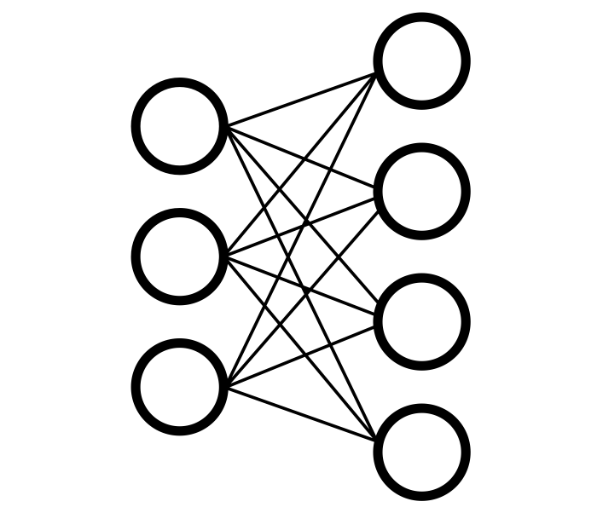
METHODOLOGY
EDA
SMOTE
CLASSIFIER
STACKING
NEURAL NETWORK
BOOSTING
01
02
03
04
05
06
Exploring Data
Sampling & Borderline
Classifying models
Multiple models
Keras/ ANN
Multiple models

Slide 4
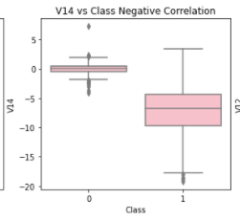
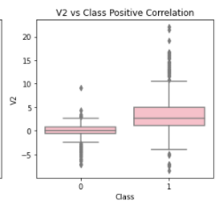
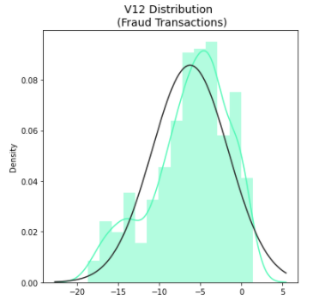
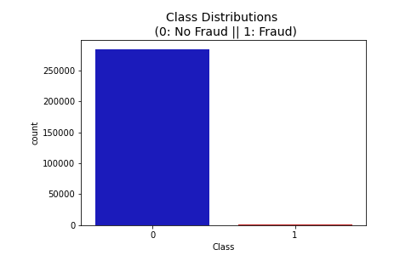
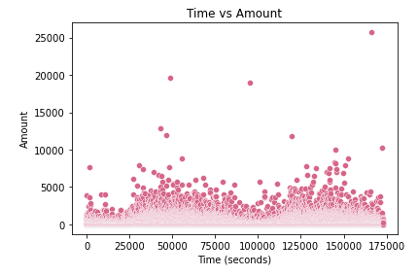
THE DATASET
Notes:
Skewed Class Distribution
Time vs Amount
Anomaly Detection & outliers via comparing PCA components to Class Negative & Positive
Distribution of V12 Distribution

Slide 5
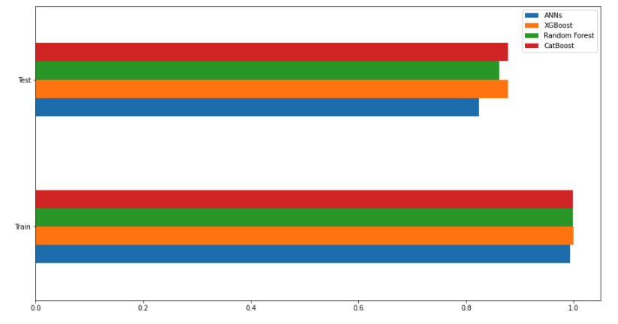
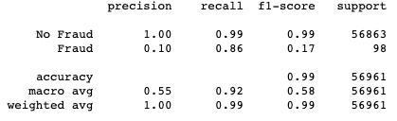

FINDINGS AND RESULTS
OVERSAMPLING SMOTE
OVERFITTING & CROSS VALIDATION
Notes:
To be edited!!!

Slide 6
SUCCESS CRITERIA
TRUE POSITIVE
ROC
CLASSIFICATION
Percent Correct Classification
False Positive vs True Positive
Lesser Imbalance
Notes:
http://www.predictiveanalyticsworld.com/machinelearningtimes/defining-measures-of-success-for-predictive-models-0608152/5519/

Slide 7
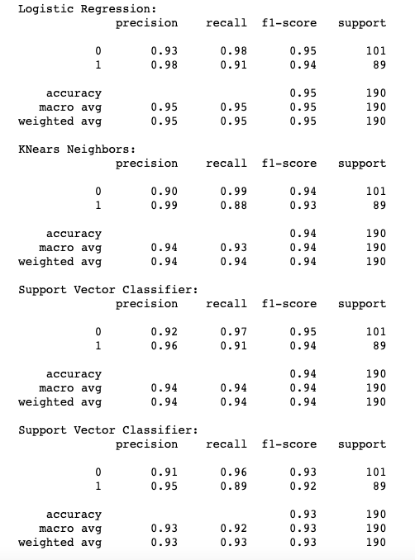
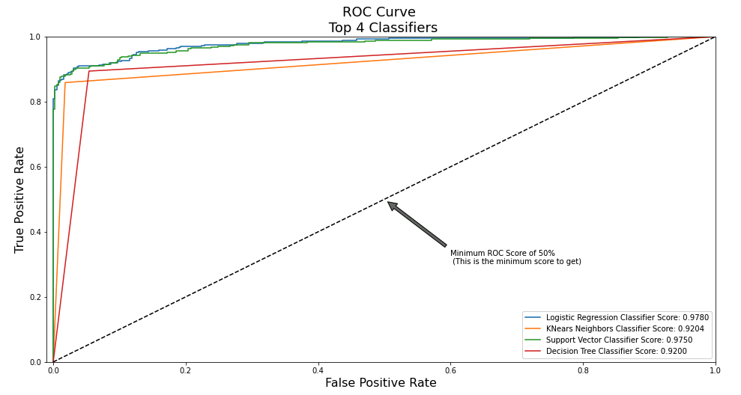
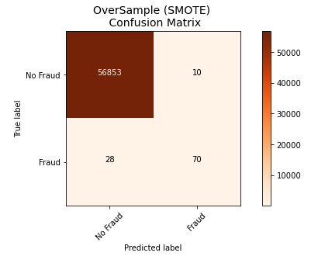
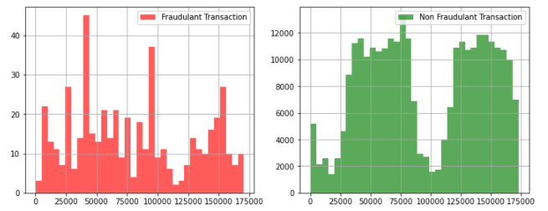
FINDINGS AND RESULTS
No. of Transactions
Reshuffled SVC
TIME (secs)
Notes:
Confusion Matrix is the validation set results

Slide 8
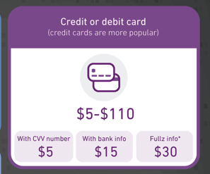

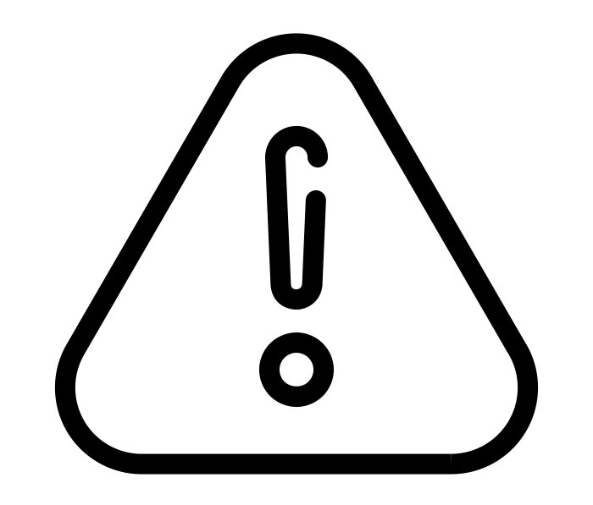

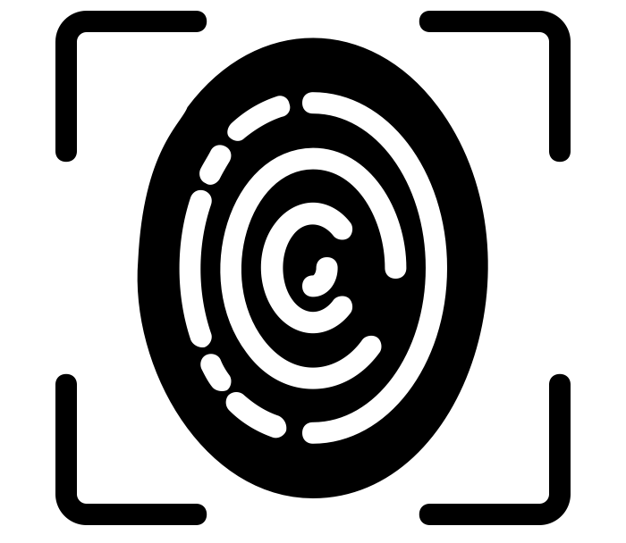
RECOMMENDATIONS
IP GEOLOCATION
BIOMETRICS IDENTIFICATION
DETECT SPEND AMOUNT
DELAY FUNDS TRANSFER
Notes:
IP GEOLOCATION

Slide 9
BUSINESS FRAMEWORK
DETECT SPEND
BIOMETRICS
PREDICTIVE ANALYSIS
(Classification)
NEURAL NETWORK
USER CONFIRMATION
TRANSACTIONS
DATABASE
DELAY FUNDS
IP GEOLOCATION

Slide 10
CHALLENGES
ALGORITHM
USED
DATASET
PERFORMANCE MEASURE
ALGORITHM
MAINTENANCE
HIGH COST OF MISCLASSIFICATION
DYNAMIC BEHAVIOUR OF FRAUDSTERS

Slide 11
FUTURE STEPS
01
SUPERVISED & UNSUPERVISED MODELS
02
CLUSTERING METRIC
03
REAL TIME ANALYTICS
04
QUALITY DATA
05
USER BEHAVIOUR
06
PINPOINTING FRAUD TIMINGS
Notes:
Using Big Data : - Design mechanisms based on machine learning and big data mining techniques that allow to automatically detect attacks and fraudulent behaviors in large amounts of transactions.
Aim is to develop a real-time framework (already in practice via the BruFence Project) that is able to compare in parallel a large number of alternative models in terms of nature (expert-based or data driven), features (e.g. history or customer related), data (e.g. supervised or unsupervised), predictive methods (e.g. decision trees, neural networks), scalability (e.g. conventional versus Map / Reduce implementation) and quality criteria (e.g. readability vs. accuracy)

Slide 12


THANKS!
Questions?
CREDITS: This presentation template was created by Slidesgo, including icons by The Noun Project, and infographics & images by Freepik

Slide 13
Appendix
https://thenounproject.com/search/?q=exploring+&i=3382694
Business Architecture https://wso2.com/whitepapers/fraud-detection-and-prevention-a-data-analytics-approach/
https://geotargetly.com/blog/can-credit-card-fraud-be-minimised-with-ip-geolocation
https://www.cardrates.com/advice/credit-card-fraud-statistics/
https://www.altexsoft.com/whitepapers/fraud-detection-how-machine-learning-systems-help-reveal-scams-in-fintech-healthcare-and-ecommerce/
1. Exposure by Christopher T. Howlett from the Noun Project
2. Explore by Monkik from the Noun Project
3. k nearest Neighbours by sachin modgekar from the Noun Project
4. Stacking by Sachin Modgekar from the Noun Project
5. RBM by sachin modgekar from the Noun Project
6. Thumb scanning by Vectors Point from the Noun Project
7. Warning by myladkings from the Noun Project

